Slide 1
Data Stream Analytics
Sumit Misra
RS Software (India) Limited
References:
Mining of Massive Data Sets, 2014 : Leskovec, Rajaraman, Ullman
Data Streams – Models and Algorithms, 2007 : Charu C Aggarwal
Notes:
Application of Big Data in Business Solutions
Abstract: The proliferation of platform economy and e/m-commerce has resulted in availability of very large corpus of data. Big Data is now being used to gain insight from these data corpus; machine learning is used to build predictive models from these data streams and adjust the models at high frequency and finally detecting outliers to utilize it for either leveraging a business opportunity or containing a risk. This session would discuss various aspects of the usage of the big data technologies that are being used for business solutions.

Slide 2
Content
Business Need
Models & Mining
Standing Queries
Conclusion

Slide 3
Business Need of Stream Analytics
How important is the space

Slide 4
Platform Business : Viral Effect
Application in Cloud
4 M / min
Big Data
Browser
Tab App
Mobile App
Billions of Users
1.32 billion active Facebook users per day
Source: https://www.wordstream.com/blog/ws/2017/11/07/facebook-statistics

Slide 5
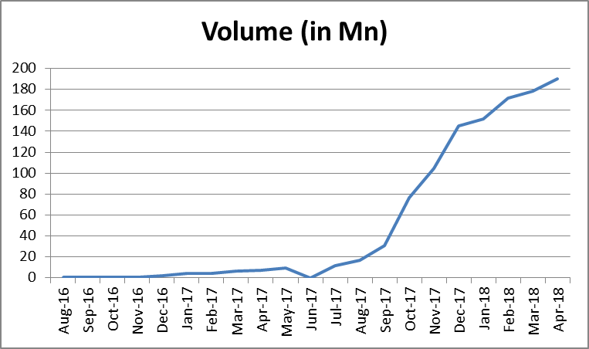
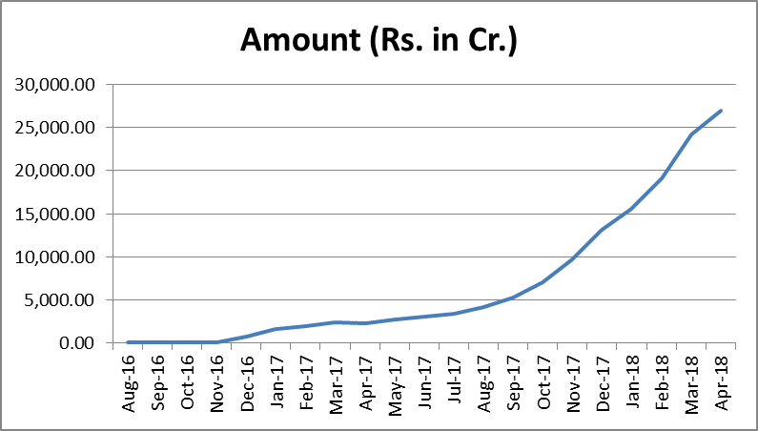
UPI Transactions
Other than Facebook no application worldwide has seen such exponential adoption in early years of launch

Slide 6
Complexity
High
Very High
Super High
Prescriptive Analytics
Medium
High
Very High
Predictive Analytics
Low
Medium
High
Descriptive Analytics
Offline
Hybrid
Online

Slide 7
Map
Entity Resolution
Filter Spam emails
Google predicts the query string and provides alternatives
Prescriptive
Page Ranking
Clustering
Stock Price Prediction
Personalized Ads / News
Amazon, Netflix Recommends
Predictive
Will X buy the car
What items are bought together
Detect Plagiarism
Trending of tweets
Fraud detection of ecommerce purchases
Descriptive
Offline
Hybrid
Online

Slide 8
Business Questions : Customer Focus
Google : How many new users have logged since last month
Uber: What should be the dynamic price that would not put off customer

Slide 9
Data Stream : Model & Mining
There is no one answer or easy answer to easy questions in data streams

Slide 10
Considerations and Approach
Constraint
We cannot store all the data from the past
The stream objects can only be scanned once
Usually we need to answer it in seconds as it provides an opportunity for the business
General Approach
Obtain a close approximate answer within a short time

Slide 11
Stream Model
How many new logins in past week?
Ad-hoc Queries
What is the highest number so far?
Input Streams
Stream Processor
1,5,2,7,4,5,2,8,9
Standing Queries
t,p,n,h,a,d,o,l,p,v,e,
Output Streams
1,1,0,1,0,0,1,0,1,0
Time
Limited Working Storage
Archival Storage

Slide 12
Mining for …
CLASSIFICATION
GOOD 15004 / MIN
FRAUD 04 / MIN
GOOD 16098 / MIN
FRAUD 06 / MIN
GOOD 6011 / MIN
FRAUD 01 / MIN
6am – 2pm
2pm – 10pm
10pm – 6am

Slide 13
Mining for …
FREQUENT ITEM SET
A | 6
G | 7
W | 5
A, G | 2
G, W | 3
A, W | 2
A, G, W | 2
A | 7
G | 6
W | 2
A, G | 4
G, W | 1
A, W | 0
A, G, W | 0
A | 1
G | 1
W | 1
A, G | 1
G, W | 1
A, W | 1
A, G, W | 1

Slide 14
Mining for …
CLUSTERS

Slide 15
Time Windows
LANDMARK
SLIDING

Slide 16
Synopsis
LANDMARK
10pm – 6am
6am – 2pm
2pm – 10pm
Count | 74
Mean (µ) | 8.5
Std Dev (σ) | 2.6
Max | 30
Min | 3
µ/σ | 3.3
Count | 243
Mean (µ) | 9.2
Std Dev (σ) | 2.1
Max | 32
Min | 2
µ/σ | 4.4
Count | 198
Mean (µ) | 6.1
Std Dev (σ) | 4.1
Max | 46
Min | 1
µ/σ | 1.5

Slide 17
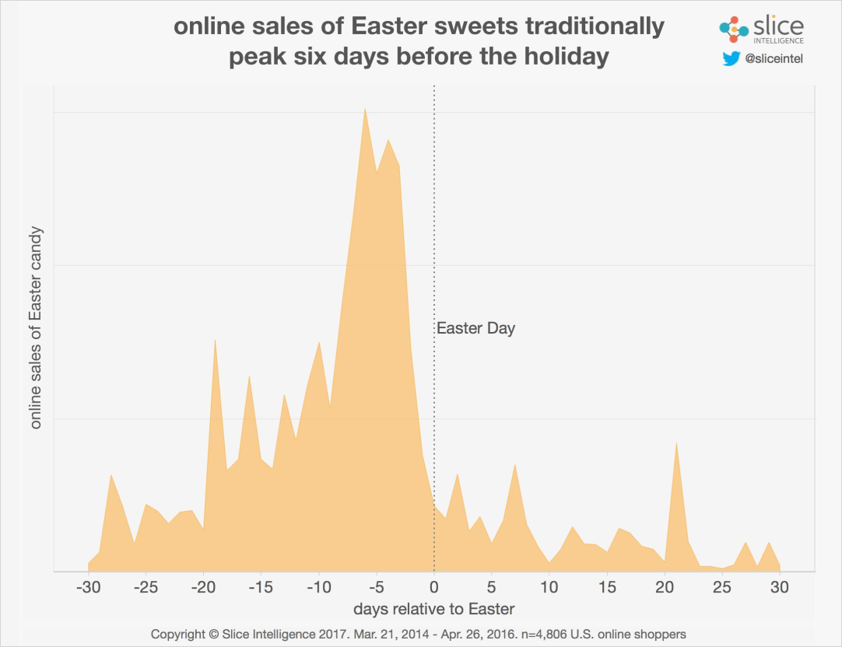
Burst of Data
Sudden online purchase due to heavy discount
Sudden cash dispensing fearing bank strike
How to reduce load?
How to gracefully degrade?
Source: http://intelligence.slice.com/blog/2017/online-candy-sales-hop-up-71-percent-for-easter-but-sales-trail-behind-the-holiday-season

Slide 18
Reduce Loads : Sampling
HASH
How do you sample if you can store only 1/10th of POS data, but
Want to process purchases that contains Item A
Want to process purchases by users that contain 2 or more of Item A
If you pick 1 in 10 sales items (query) it will work for 1 but not for 2.
For 2, you need to pick 1 in 10 users.

Slide 19
Reduce Loads : Sampling
What if the rate of arrivals increase and you cannot keep 1/10th?
Strategy: Find a sample size which will ensure
[|p_{e}-p_{a}|> ε] < δ
p_{a} : Actual Fraction
p_{e} : Estimated Fraction
ε : Relative Error
δ : Error Bound
Hoeffding Inequality

Slide 20
Hoeffding Inequality
Probability [|p_{e}-p_{a}|> ε] < δ
If there are N sample tokens and each token X_{i} can take value from interval [a_{i}, b_{i}]
If Y = Σ X_{i}, where X_{i} is value of a sample token, for all α > 0
Pr[|Y – E(Y)| > Nα] < (2.exp (- $\frac{\text{2}\text{(}\text{N}\text{α}\text{)}\text{2}}{\text{Σ}\text{(}\text{Ri}\text{)2}}$ ))
Where R_{i} = (b_{i} – a_{i})
If R=1, i.e. value interval is [0,1]
If (Nα =β)
Pr[|Y-E(Y)>β] < 2*exp(-2*β²)
Fraud 1.7%, Sample N=100
Pr[|Y-E(Y)| > Nα] < 0.6%

Slide 21
Research and Innovations
Innovative synopsis data structures (list, trees, graphs, clusters, …), optimized for
Latency of search response
Time complexity of update
Space complexity of storage

Slide 22
Classification / Filtering
Bloom Filter
(1970)
How do you filter out an email id as a good one and not a spam?
Typical email address is 20 bytes
Strategy if we have 1 GB memory = 8 billion bits
Map hash of good addresses to a bit location
Hash to 8 billion memory address and mark 1 on location of hash
Pre-process
email
49..01
0
49..02
1
49..03
0
Refer / Read
49..04
0
email
Hash to memory address and check if it has a 1 or 0
49..05
0
49..06
1
49..07
0
Assuming very large spam percentage, this will eliminate about 80% of spams

Slide 23
Classification / Filtering
Bloom Filter
(1970)
False Positive is act of wrongly classifying spam as non-spam
In the example:
Using one hash function FP probability is 11.75%
Using two has functions FP probability is 4.89%
Intuition:
This technique may also be used to count shopping cart that has a set of items (A, B, C)

Slide 24
Frequent Recent Items
For a large universal set (N), want to find top 5 most frequent recent items (Swiggy Orders, Uber Requests, TV channels viewed)
Have a set of counters where the item-ids hash
Counters store counts which exponentially (α: [0..1]) decays with time (Δ)
Report items mapped to top 5 counts
Hash (Item ID)
***
1+Cα^{Δ}
***
4621
4622
4623
4624
4625
4626

Slide 25
Frequent Recent Items
For a large universal set (N), want to find top 5 most frequent recent items (Swiggy Orders, Uber Requests, TV channels viewed)
Have a set of counters where the item-ids hash
Counters store counts which exponentially (α: [0..1]) decays with time (Δ)
Report items mapped to top 5 counts
Metrics
Latency of search of top 5 : O(1)
Time complexity of update : O(|w|) + O(N.log(N))
Space complexity : O(N)
Pruning can reduce this part

Slide 26
Measuring Data Uniformity : Estimating Moments
Moments for Stream : 1, 3, 2, 1, 2, 3, 4, 3, 1, 2, 3, 1
Occurrences: 1(x4), 2(x3), 3(x4), 4(x1)
0th Moment = 4⁰+3⁰+4⁰+1⁰ = 4 (Distinct Items)
1st Moment = 4¹+3¹+4¹+1¹ = 12 (Steam Length)
2nd Moment = 4²+3²+4²+1² = 42 (Surprise Number)
Surprise Number
Stream Length
Distinct Items
1 ::
3 ::
10

Slide 27
Measuring Data Uniformity : Estimating Moments
Surprise Number?
Stream Length is 100 and has 11 Distinct Items
Range of 2nd Moment
10x9²+1X10² = 910 ---------- Evenly Distributed
10x1²+90² = 8110 --------- Unevenly Distributed
Uneven
Even

Slide 28
Standing Queries
How to answer to known queries while handling data streams

Slide 29
Standing Queries
Approximate Answers
Distinct Items = Flajolet-Martin Algorithm
Counting 1s in last N bits of bit-stream = Datar-Gionis-Indyk-Motwani Algorithm
2nd order Moments = Alon-Matias-Szegedy Algorithm

Slide 30
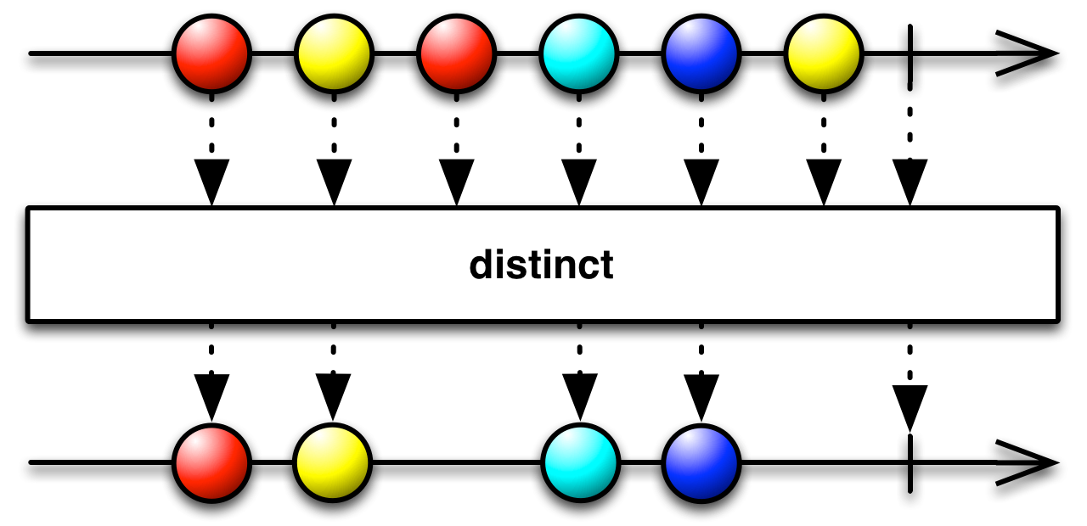
Distinct Items : Removing the repetitions
Source: www.github.com

Slide 31
Distinct Items
Flajolet-Martin Algorithm (1983)
Lets work out an algorithm
Stream: 1, 3, 2, 1, 2, 3, 4, 3, 1, 2, 3, 1...
Hash Function: f(x) = (3x + 1) mod 5
Stream post hash: 4, 5, 2, 4, 2, 5, 3, 5, 4, 2, 5, 4
Convert to binary and count # trailing 0 --- R
It is: 2, 0, 1, 2, 1, 0, 0, 0, 2, 1, 0, 2
Max R = 2
Probabilistic Estimate of Distinct Element M = 2^{R} = 2² = 4

Slide 32
How many buyers are from the age group of 18-28 years
Source: www.dailyrecord.co.uk

Slide 33
Counting 1’s in a Window
*
*
1
0
1
1
0
1
1
0
0
0
1
0
1
1
1
0
1
1
0
0
1
0
1
1
0
Timestamps
40
41
42
43
44
45
46
47
48
49
50
51
52
53
54
55
56
57
58
59
60
61
62
63
Bucket
(41,8)
(49,4)
(55,4)
(59,2)
(61,1)
(62,1)
Window divided into buckets represented by
Timestamp of right end
Size : Number of 1’s in a bucket (pow. of 2)
Estimating 1’s in last k=10 bits
Exact Count = 5
Estimate = Sum size of all but last and add ½ of the last bucket
= (1) + (1) + (2) + (4÷2) = 6
k = 10 bits
How many 1’s in last 10 (k) bits?
DGIM (2002)

Slide 34
Estimating Moments …
Alon-Matias-Szegedy (AMS) Algorithm
Example Stream: a, b, c, b, d, a, c, d, a, b, d, c, a, a, b
n=15; a(x5), b(x4), c(x3), d(x3); 2nd Moment = 59
Estimate = n * (2 * X.value − 1)
Pick random positions X1(3rd), X2(8th), X3(13th)
X1.element = “c”, X1.value = 3 (# of “c” in the set from 3rd place)
Estimate for X1= 15*(2*3-1) = 75
Estimates for X2 = 15*(2*2-1) = 45, (# “d” beyond 8th place = 2)
Estimate for X3 = 45, (# “a” beyond 13th place = 2)
Average for X1, X2, X3 = 165/3 = 55 (close to 59)

Slide 35
… Estimating Moments …
Dealing with Infinite streams
Challenge is not the “n” as we store one variable per randomly chosen position
Challenge is selecting the position
At start
After sometime
After significant time

Slide 36
… Estimating Moments …
Strategy for position selection assuming we have space to store “s” variables and we have seen “n” elements
First “s” positions are chosen
When (n+1)^{th} token arrives, randomly select positions to keep
If (n+1) is selected discard from existing n position randomly and insert new element with value 1

Slide 37
Finding needle in haystack … with perseverance ☺
Source: https://plus.google.com/+GaiaCostantino

Slide 38
… in form of equation …
FINDING NEEDLE IN HAYSTACK
Very large number of tuples [$n→∞$]
Very low probability of finding what you want
PERSEVERANCE
Equals large number of trials
PROBABILITY OF MISSING =
$$\lim_{n→∞}{{\left(1−\frac{1}{n}\right)}^{n}}$$
$\lim_{n→∞}{{\left(1−\frac{1}{n}\right)}^{n}}$ = $e^{−1}$ = 0.368 = 36.8%

Slide 39
Conclusion
To sum it up …

Slide 40
Conclusion
Mining Data Stream has moved from research area to every day use for commercial purposes
With single scan constraint algorithms suitable for static data mining cannot be applied as-is
Finding distinct items, count of items in last n-occurrences, uniformity of item values, etc. represents a few use-cases
This remains an active area of research as it can be applied across disciplines and hence needs due attention

Slide 41
Questions
Answers

Slide 42
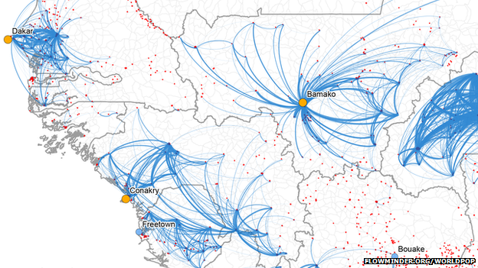
Ebola Virus: Predict spread using mobile phone data from West Africa
Mar 23, 2014 (WHO reported after 29 deaths, started Dec ‘13)
Mobile phone data from West Africa is being used to map population movements and predict how the Ebola virus might spread
Source: http://www.bbc.com/news/business-29617831
Notes:
This is mining data stream

Slide 43
Thanks
sumit@rssoftware.co.in
+91.9830336049

